Slide 1
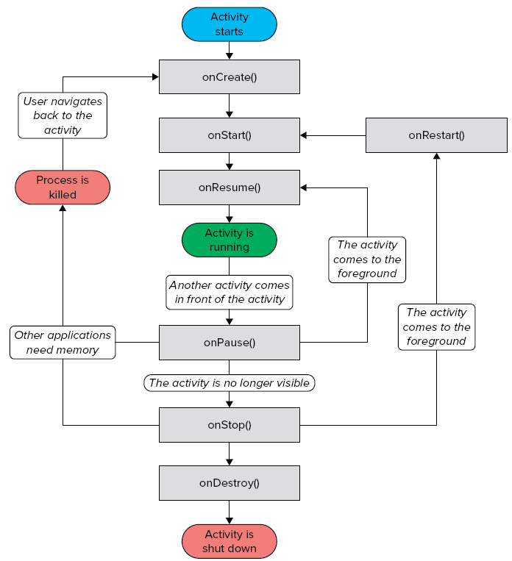
Android Activities
An application can have one or more activities, where
Each activity
Represents a screen that an app
present to its user
Extends the Activity class
Activity's event handlers
onCreate(): when first created
onStart(): when visible
onResume(): when interactive
onPause(): when paused
onStop(): when no longer visible
onDestroy(): prior to destruction
onSaveInstanceState(Bundle)

Slide 2
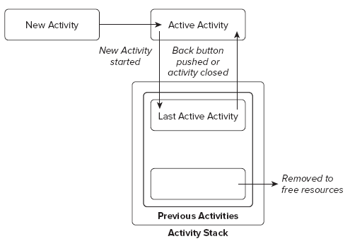
Activity States
The state of an activity depends on
Its position in the Activity stack
Activity states
Active
Activity at the top of the stack
Paused
Activity does not have focus
Stopped
Activity is not visible
Inactive
After an activity has been killed

Slide 3
Event Handlers to Monitor State Changes
Event handlers are defined to
Enable activities to react to state changes
Full lifetime:
Between onCreate and onDestroy
Visible lifetime:
Bound between onStart and onStop
Active lifetime
Starts with onResume and ends with onPause

Slide 4
Applying Themes to an Activity
By default,
An activity occupies the entire screen
However,
One can apply a dialog theme to an activity
This way, it displays as a floating dialog
How?

Slide 5
Applying Themes to an Activity (Cont’d)
One can hide the title of an activity
By applying the following theme to your application:
@android:style/Theme.NoTitleBar
Refer to
ActivityAsDialog Android project

Slide 6
Techniques for Handling Orientation Changes
2 techniques are available
Anchoring
Anchor views to edges of the screen
Can be done by means of RelativeLayouts
Resizing and repositioning
Resize every view as a function of the current orientation
Refer to AlternativeLayouts Android project

Slide 7
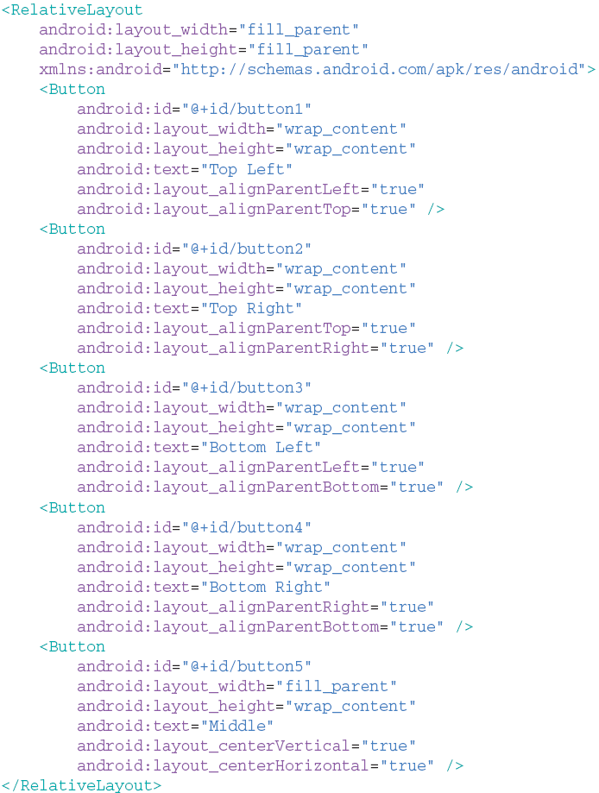
Anchoring views
RelativeLayout
Does the trick
On orientation change
Buttons remain
Anchored to screen edges

Slide 8
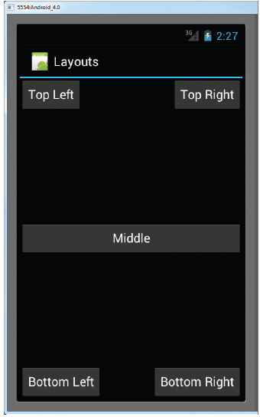
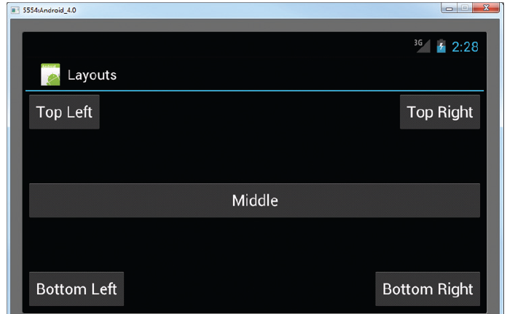
Output

Slide 9
Resizing and Positioning
Idea
Create a different layout for each mode
By creating a new subfolder under res
Named layout-land
This way, there will be
main.xml contained in layout
Defining UI for portrait mode
main.xml in layout-land
Handling UI in landscape mode

Slide 10
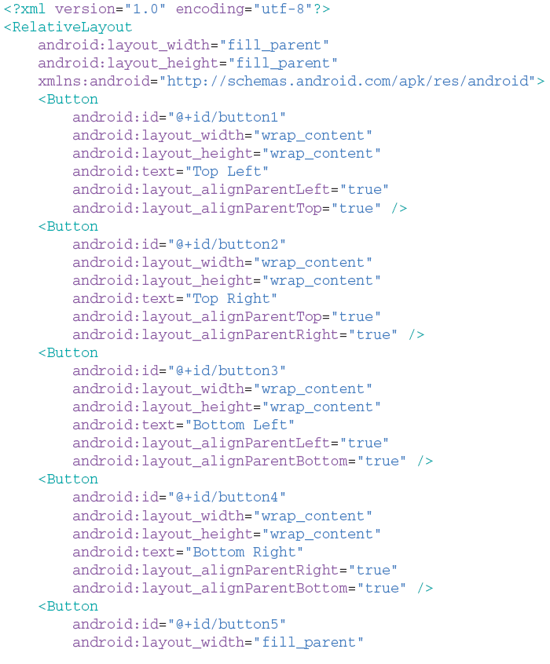
Example: layout

Slide 11
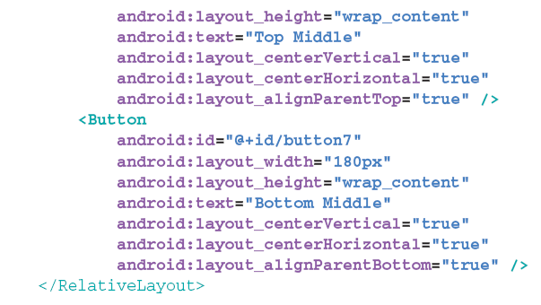
Example: layout-land

Slide 12
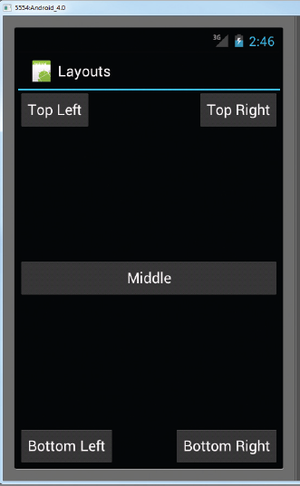
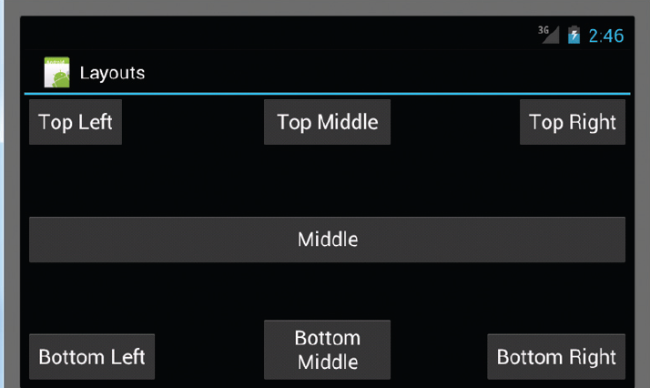
Output

Slide 13
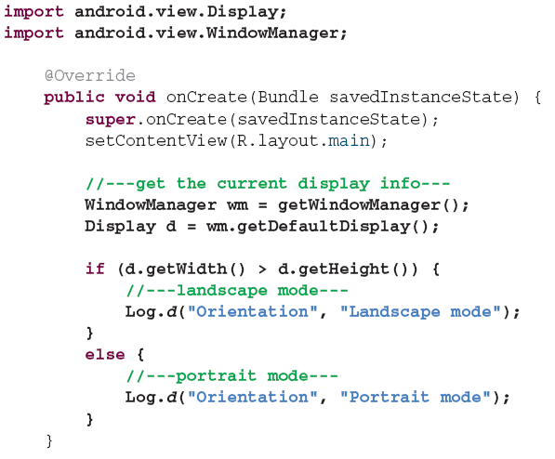
Detecting Orientation Changes
Device’s current orientation
Can be detected during runtime as follows:

Slide 14
Controlling Orientation of An Activity
A change in orientation
Can be forced programmatically as follows

Slide 15
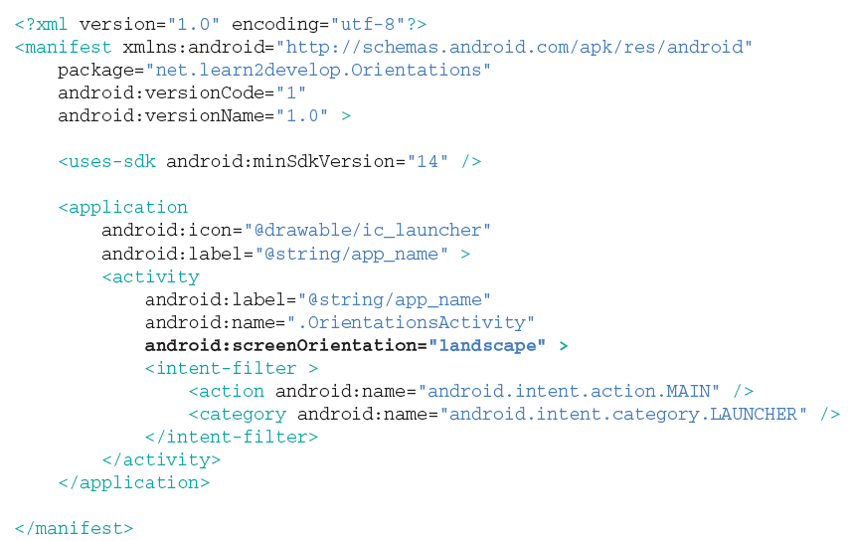
Alternative Method for Controlling Orientation
Alternatively, orientation can be forced as follows

Slide 16
Implication of Orientation Changes
Problem
Changing screen orientation destroys activity and recreates it
On recreation, current state of activity could be lost
=> Need to preserve the state of an activity
Fixes
Implement the onSaveInstance() method
Use SharedPreferences class
Refer to PreservingStateApp Android project

Slide 17
Fix#1: onSaveInstanceState
Idea
Preserve state and restore it later
Use the Bundle object to save current state:
Upon recreation, retrieve state saved previously:
Limitation
Not adequate for recovering complex data structures

Slide 18
Fix#2: Using SharedPreferences
SharedPrefernces
Points to a file containing key-value pairs
Providing simple methods to read and write them
By:
Getting a reference to a SharedPreference:
then, writing to a shared preference:
Then finally, reading data from shared perference
Context context = getActivity(); SharedPreferences sharedPref = context.getSharedPreferences( getString(R.string.preference_file_key), Context.MODE_PRIVATE);
SharedPreferences sharedPref = getActivity().getPreferences(Context.MODE_PRIVATE); SharedPreferences.Editor editor = sharedPref.edit(); editor.putInt(getString(R.string.saved_high_score), newHighScore); editor.commit();
SharedPreferences sharedPref = getActivity().getPreferences(Context.MODE_PRIVATE); int defaultValue = getResources().getInteger(R.string.saved_high_score_default); long highScore = sharedPref.getInt(getString(R.string.saved_high_score), defaultValue);

